Slide 1
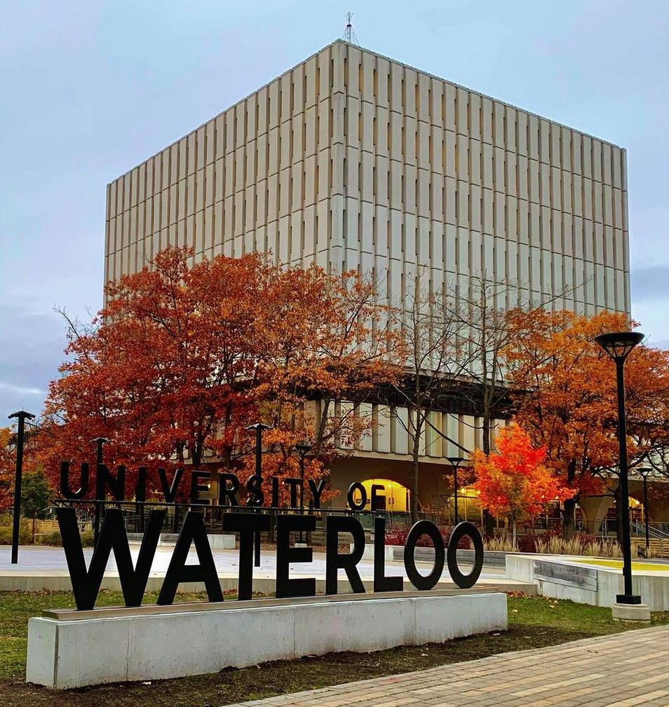
A LOW-COST, RECONFIGURABLE THIN-FILM INSPECTION SYSTEM
TOWARDS LARGE AREA THIN-FILM REFLECTOMETRY
Silas Ifeanyi, Nanotechnology MME PhD Student
Alex Zheng, Mechatronics Undergrad Student
Ian Jinzo MacPherson, Mechatronics Undergrad Student
Photo credit: @bruce.digital

Slide 2
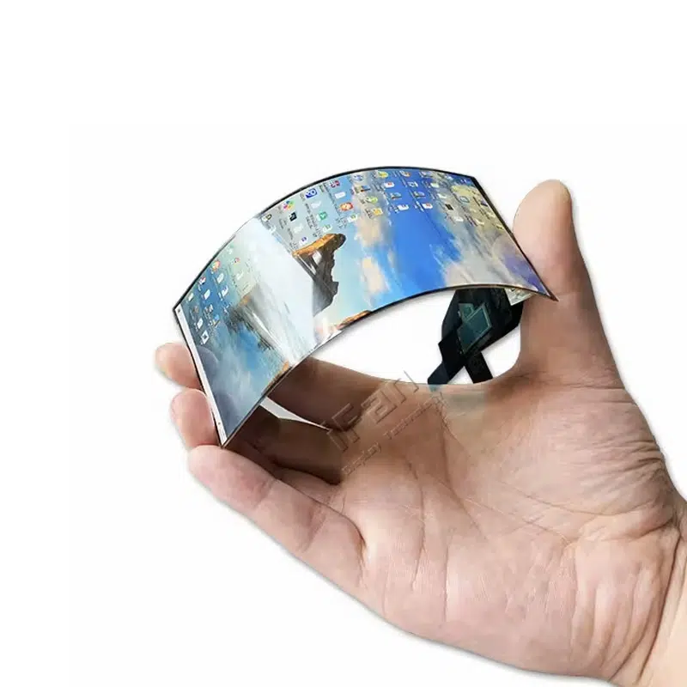
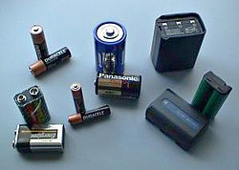


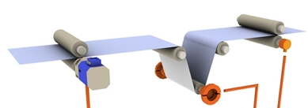
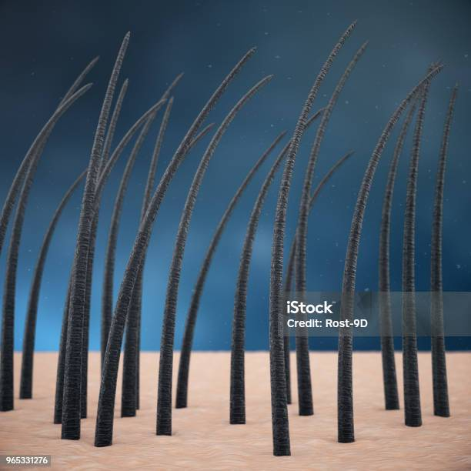
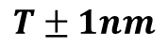
OVERVIEW
THIN-FILMS
DISPLAYS
BATTERY CELLS
FOOD PACKAGING
What are Thin Films?
Motivation
Challenges
State of the Art
Approach
Status
Future work
SOLAR CELLS
$$T±1nm$$
min: 2 nm; max: 150 nm
For Reference, A single strand of human hair is approximately 60,000 to 120,000 nm wide
ILLUSTRATION OF INDUSTRIAL THIN-FILM INSPECTION
PAGE 2

Slide 3
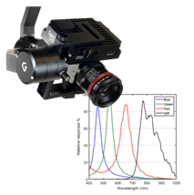
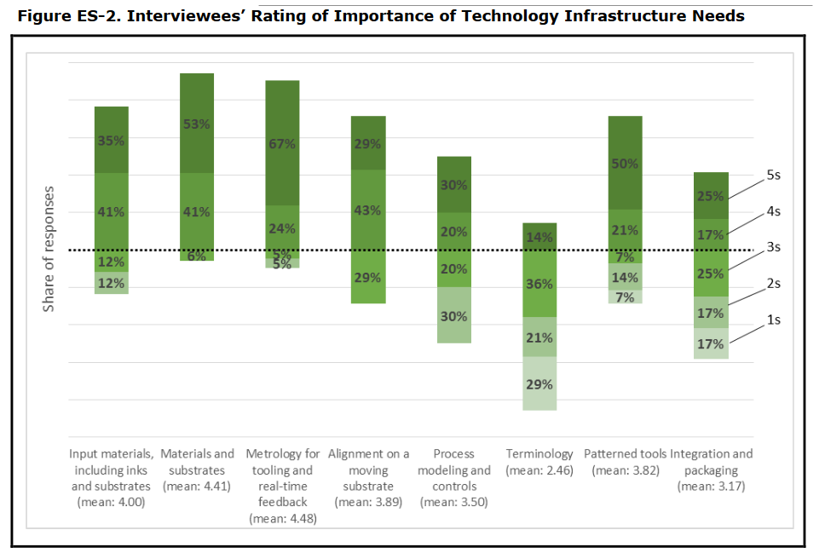
MOTIVATION
“Metrology has not kept up with thin-film manufacturing speeds” (Maize et al, 2022; NIST 2016)
Large-area thin films are everywhere!
used in PV, displays, batteries, and packaging
Industry often needs 100% inline, real-time inspection
CHALLENGES
Metrology is too computationally heavy or too slow
Also, too expensive
IMPORTANCE OF METROLOGY IN R2R MANUFACTURING
PAGE 3

Slide 4
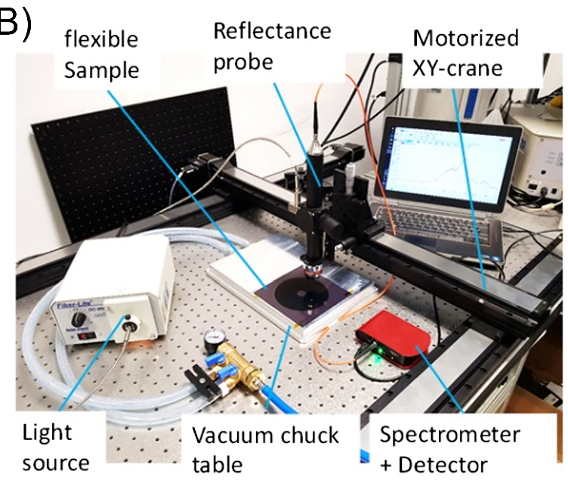
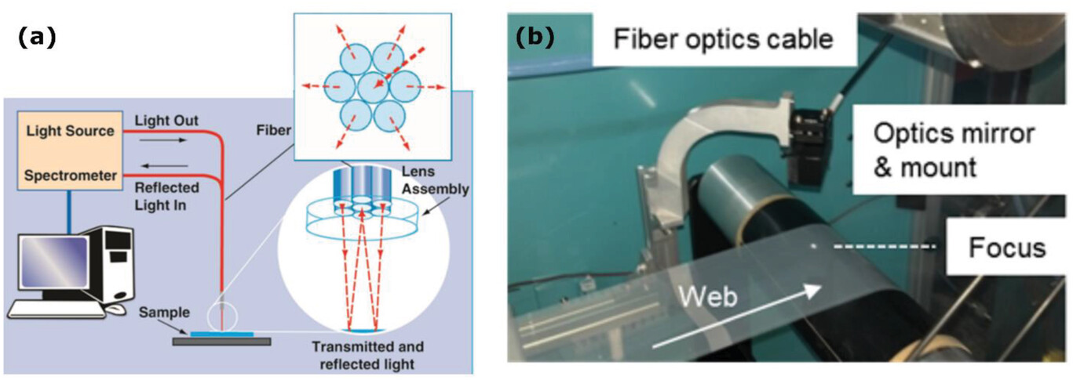
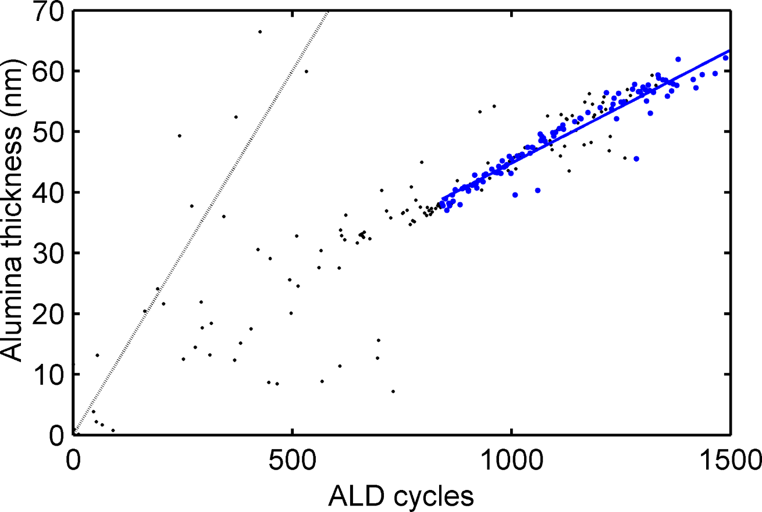
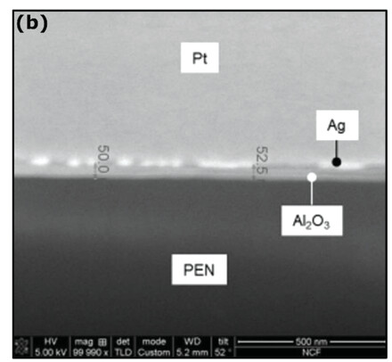
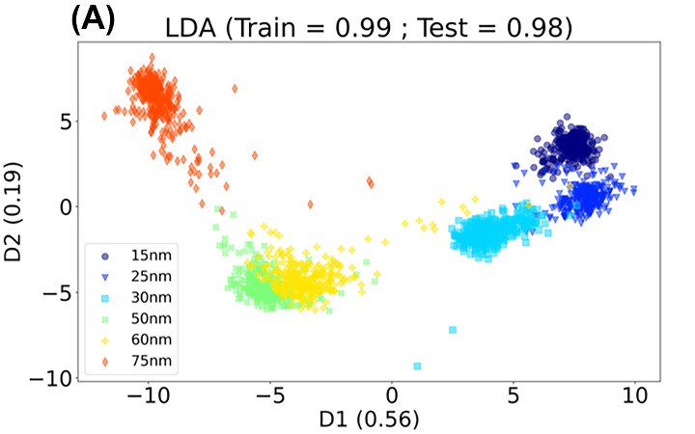
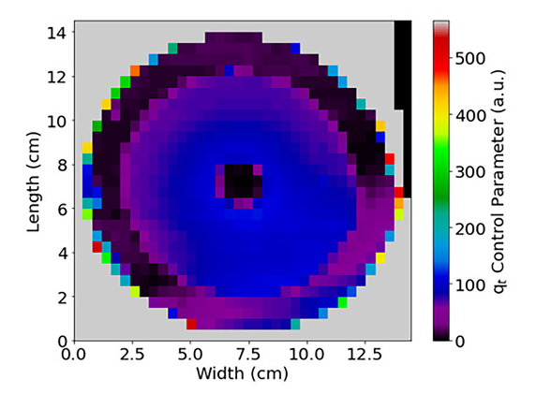
STATE OF THE ART
AREA MAPPING INSPECTION
POINT THIN FILM INSPECTION
ALL USE FULL
REFLECTANCE SPECTRA
(HYPERSPECTRAL)
WHICH CAN BE COMPUTATIONALLY HEAVY
and COSTLY
FOR 52NM ALD MOVING AT 1M/S AL₂O₃ (2014)
25NM ALxO FILM ON SILICON, (ENRIC, 2021)
PAGE 4

Slide 5
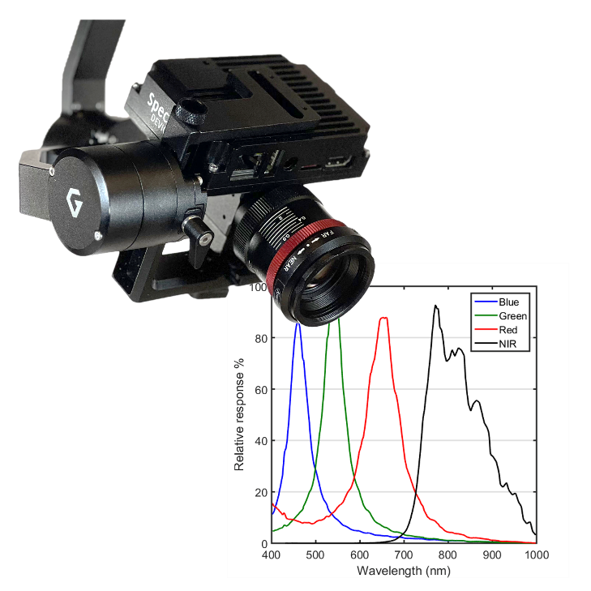
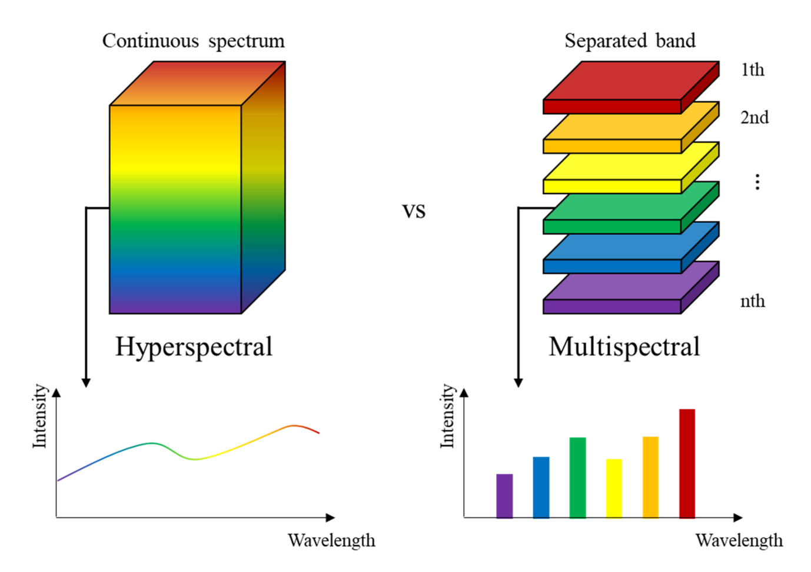
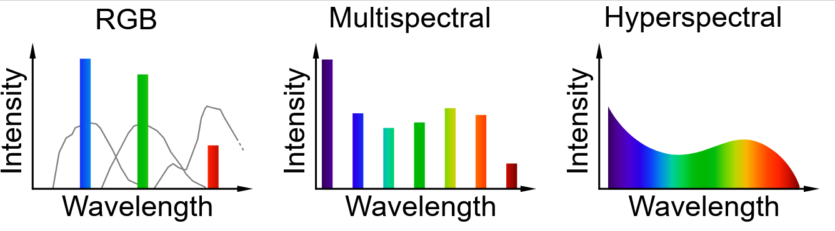
BACKGROUND
APPROACH
Multispectral and RGB Cameras have less spectral resolution
Each pixel adds spectral/color data
3 channels for RGB, ~1000 for Hyperspectral
Use multispectral/RGB cameras instead.
Less computation = Fast! (3 Channels vs 1000 Channels)
Less expensive! ($300 vs $100,000)
REDUCED SPECTRAL RESOLUTION WITH HYPERSPECTRAL
ILLUSTRATION OF INDUSTRIAL THIN-FILM INSPECTION
PAGE 5

Slide 6
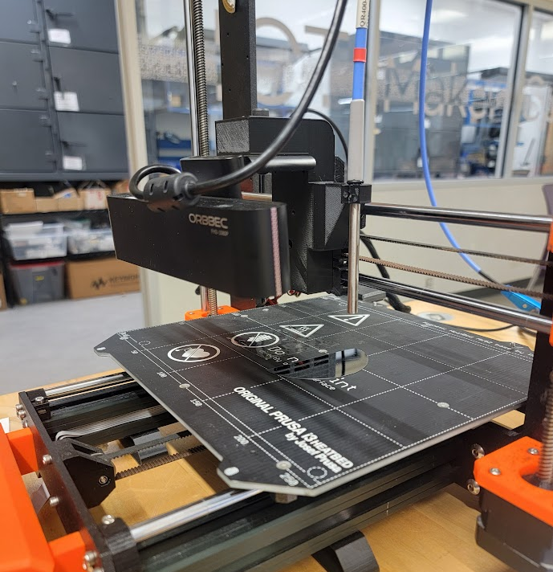
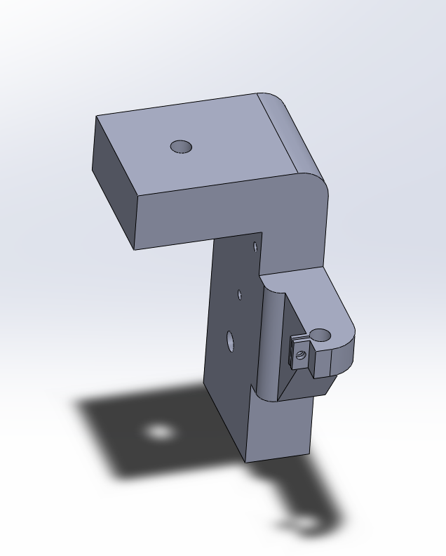
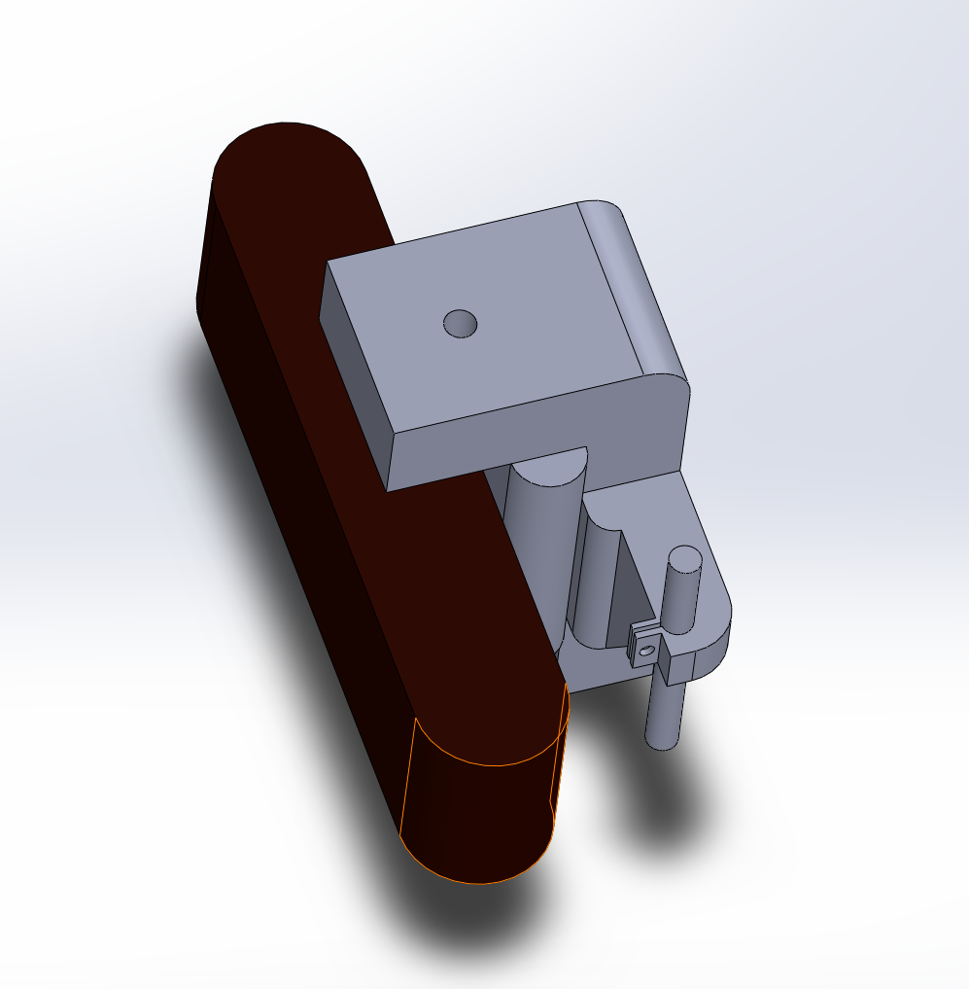
APPROACH – GANTRY DESIGN
Prusa 3D MK3s was adapted to create an operational gantry
A rig was designed and built to attach camera and spectrometer to the gantry
3D CAD OF CAMERA AND SPECTROMETER JIG
PICTURE OF ASSEMBLED SYSTEM

Slide 7
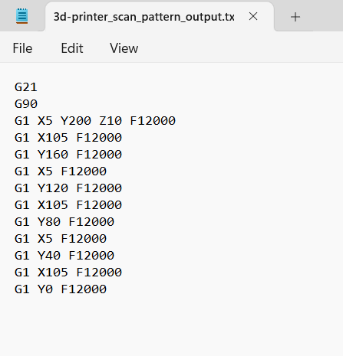
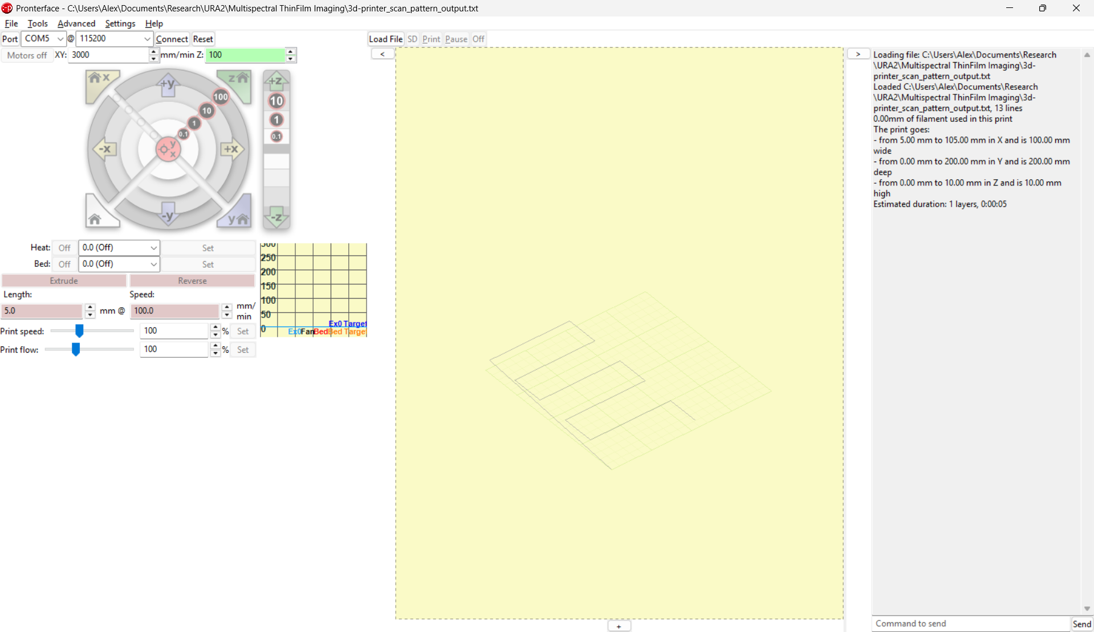
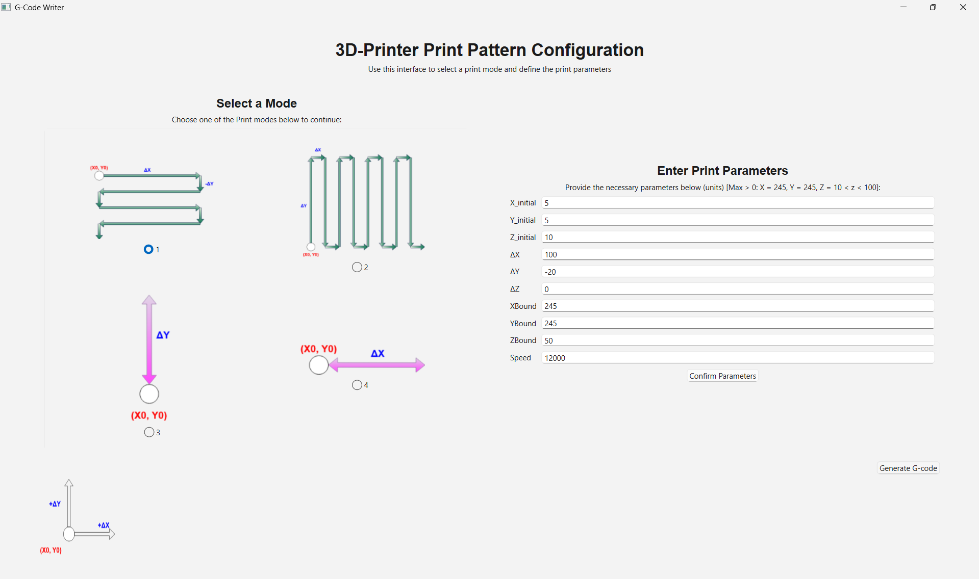

APPROACH - USER INTERFACE
A user interface was built to turn user instruction into machine procedure
PRONTERFACE
G-CODE
PATH
MACHINE CODE
USER INTERFACE

Slide 8
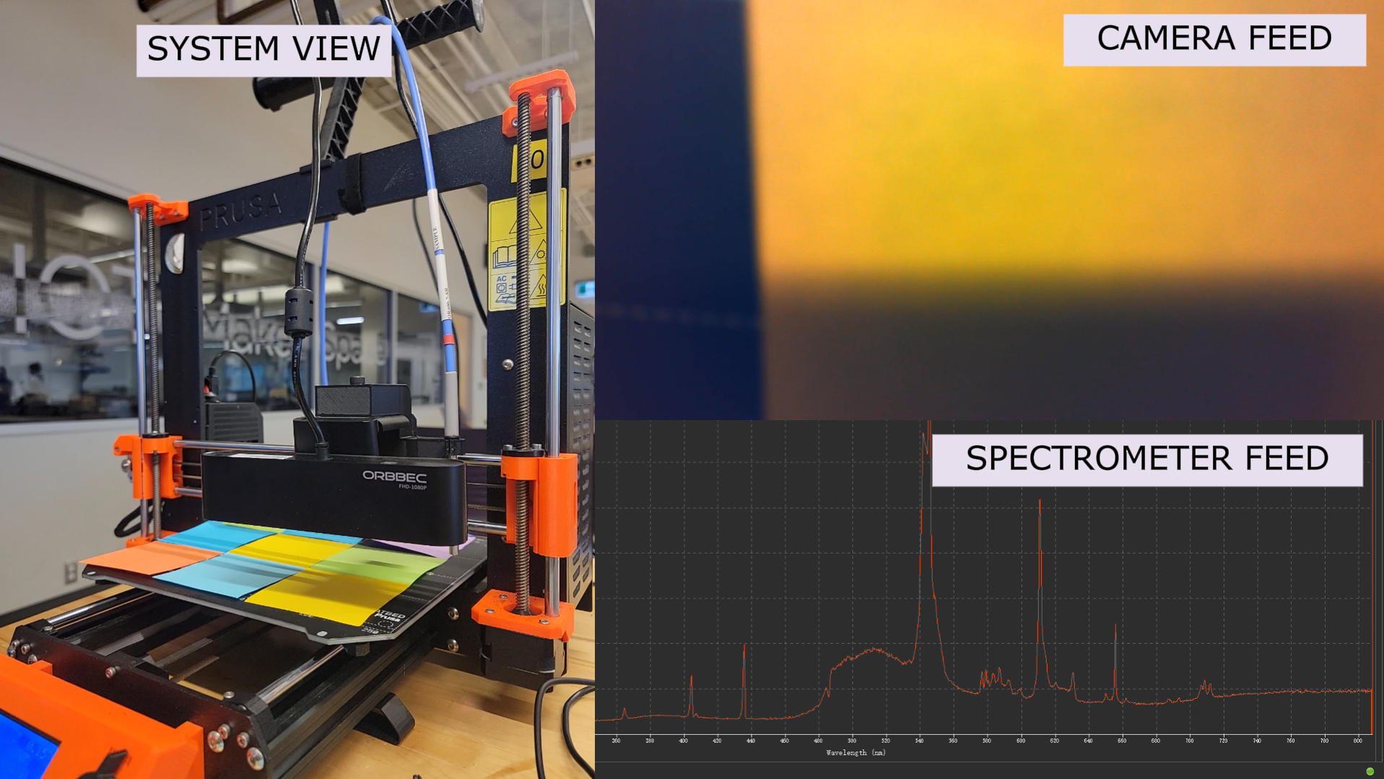
STICKY NOTE TEST!
Simultaneously capture full spectrum and 3-channel spectrum
Can analyze spectra to extract thickness
CAPTURE OF STICKY NOTE ARRAY
PAGE 8

Slide 9
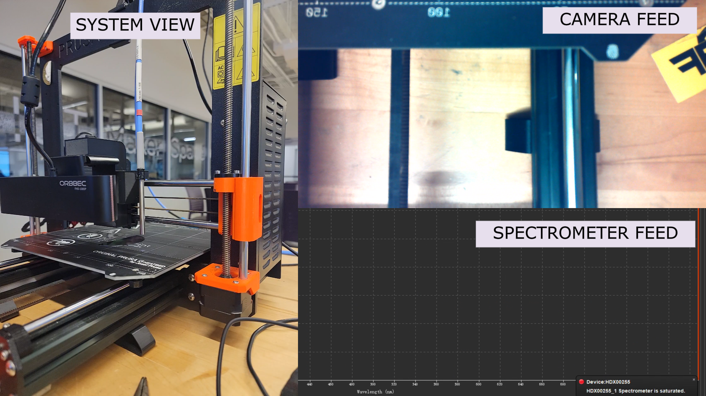
SAMPLE TEST!
Simultaneously capture full spectrum and 3-channel spectrum
Can analyze spectra to extract thickness
CAPTURE OF SILICON WAFER AND PLA SHEET
PAGE 9

Slide 10
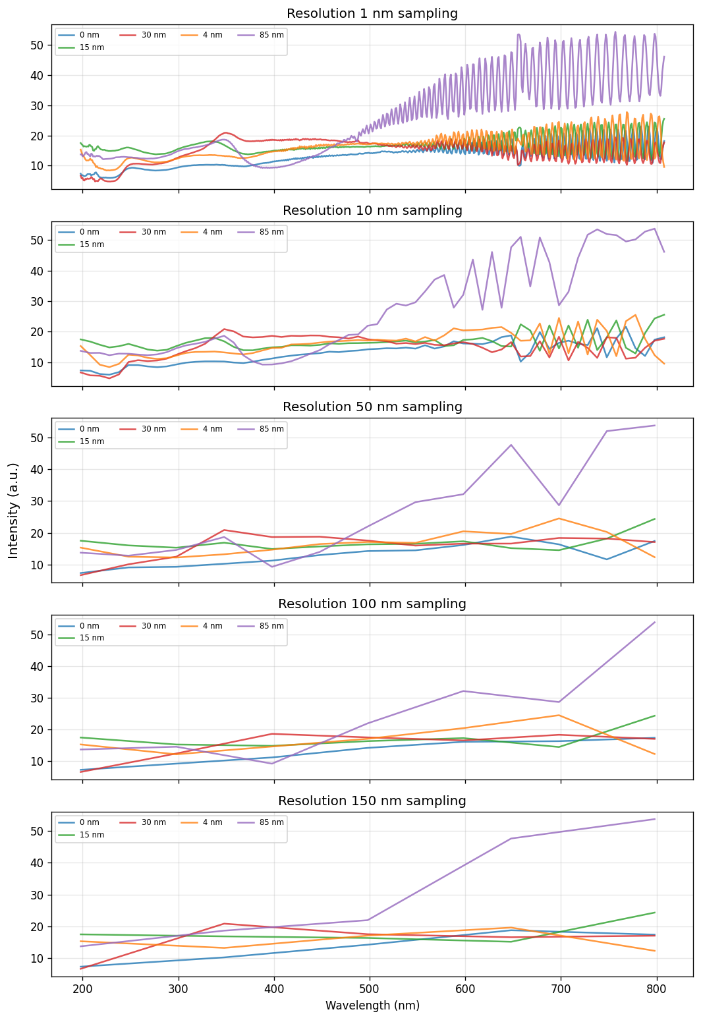
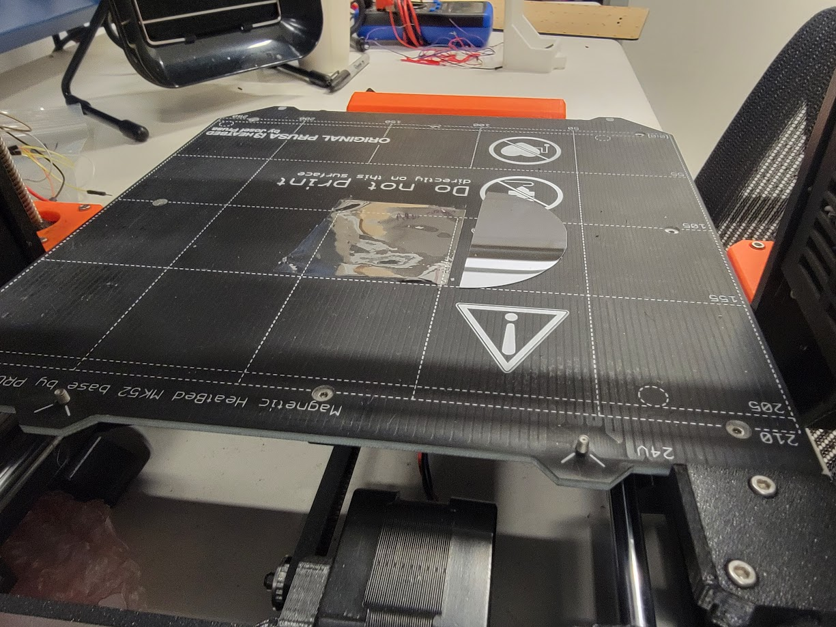
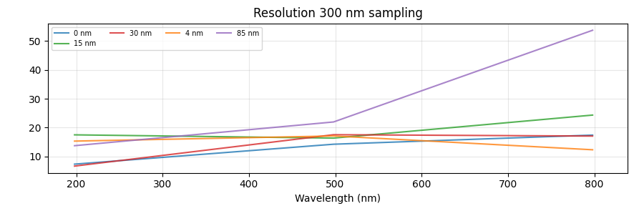
PRELIMINARY ANALYSIS
Spectrometer
Multispectral
For Reference, A single strand of human hair is approximately 60,000 to 120,000 nm wide
Spectrometer
RGB
Can see 85nm vs 30nm !
55nm difference!
IMAGES OF SAMPLE ON STAGE
SPECTRAL RESOLUTION REDUCED BY BINNING AND AVERAGING
PAGE 10

Slide 11

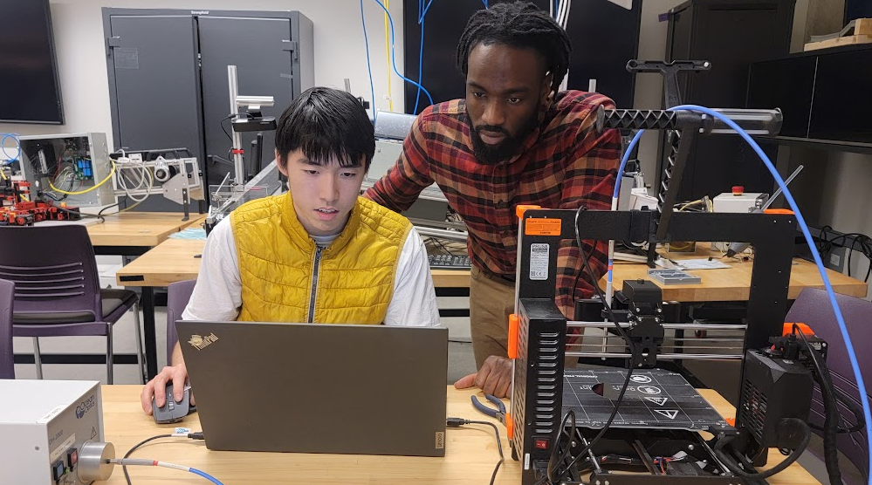
FUTURE WORK
THANK YOU!
Improve UI and Camera rig
Test on more samples (from partners)
Increase metrology accuracy
Integrate into real system
ILLUSTRATION OF INDUSTRIAL THIN-FILM INSPECTION
PAGE 11

Slide 12

Questions?

